Slide 1
Customer Discovery 1

Slide 2
Please answer the following questions regarding a proposed company that aims to connect health records across state lines, allowing for the longevity and accuracy of health records and incorporate patient connections from general to specialized doctors based on health coverage.

Slide 3
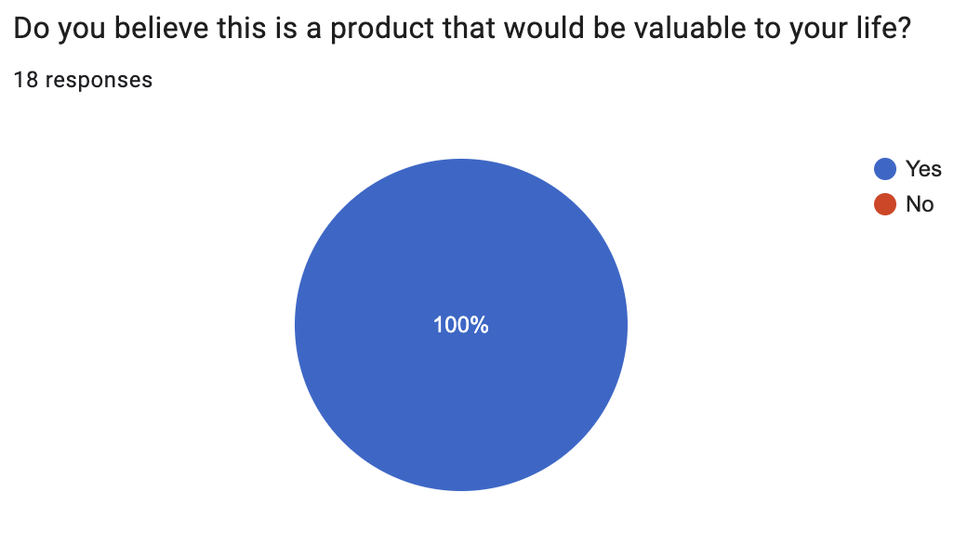

Slide 4
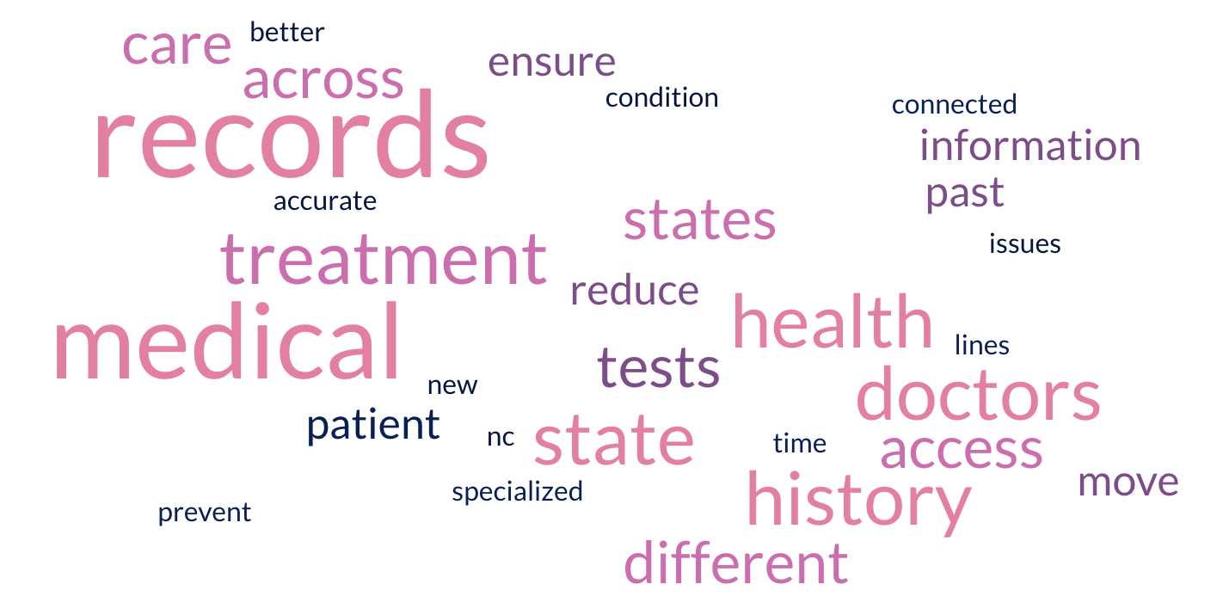
Please briefly explain why

Slide 5
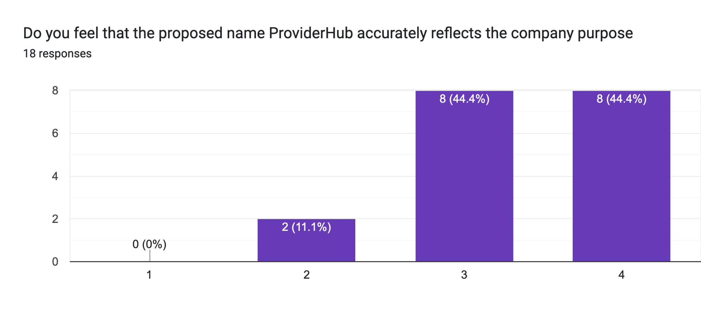
Strongly disagree Somewhat disagree Somewhat agree Strongly agree

Slide 6
